Slide 1

Q-Learning with an example
Antonio Jose Morano Moriña

Slide 2

What’s Q-Learning?
Is a type of Reinforcement learning
Involve model free enviroment
Uses a trial-an-error-based approach

Slide 3
Q-Values
A Q-Value tells us the quality of a determinate action in a given state: Q(S,a)
They are our current stimate of the future rewards , then this values increase when we are close to the best reward.
This are stored on a Q-table, which has one row for each state and one column for each action
An optimal Q-Table has values that lead us to the optimal path to the highest reward

Slide 4
Temporal differences
Is the method we use to calculate how much should the Q-values for the previous action should be changed depending on the q-values our agent gets for the current state’s action.

Slide 5
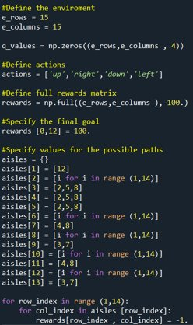
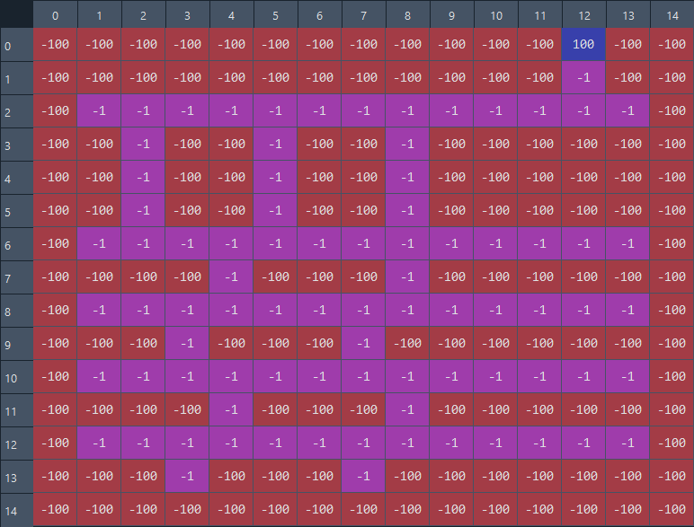
Setting up the example
Here we specify how is our enviroment for the problem, the we create the q-value table , with a 3d array , matching the enviroment size and having a dimesion to track the values of state-action pairs.
To create the complete 'map' I've used a dictionary where every aisle correspond to the columns of a row , and the position inside every aisle , make the path.

Slide 6
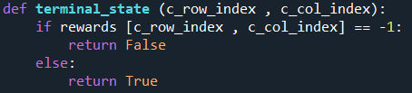
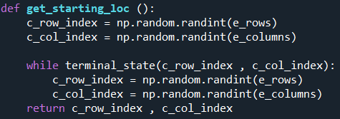
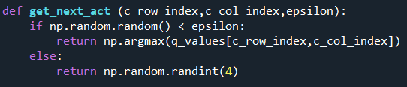
Auxiliars functions

Slide 7
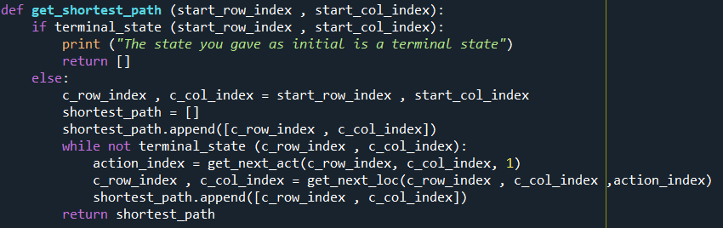
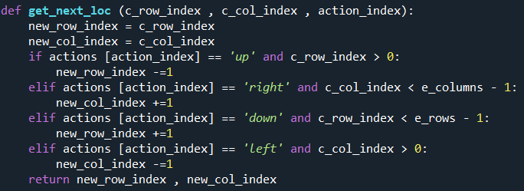
Auxiliars functions

Slide 8
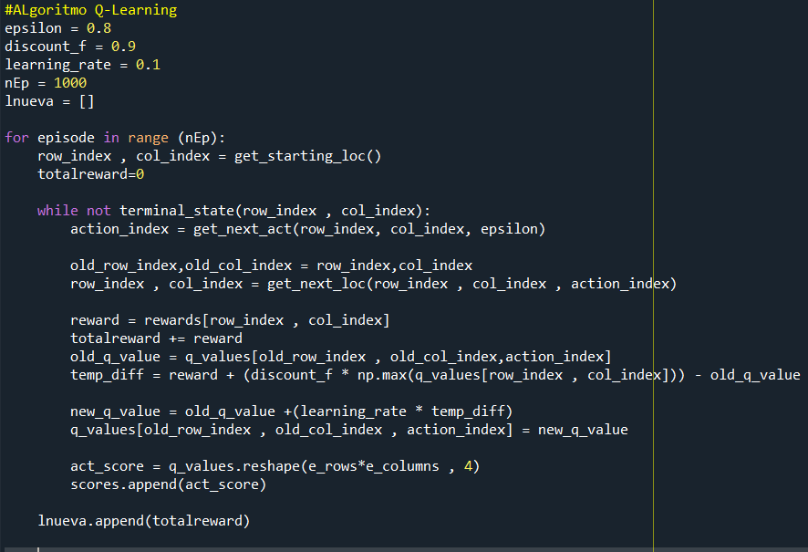
Algorythm it self

Slide 9
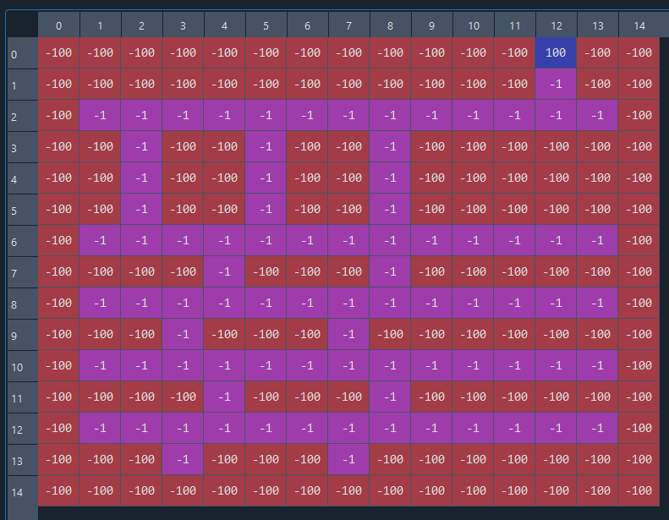
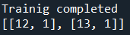
Results
1500 iterations
750 iterations
100 iterations

Slide 10
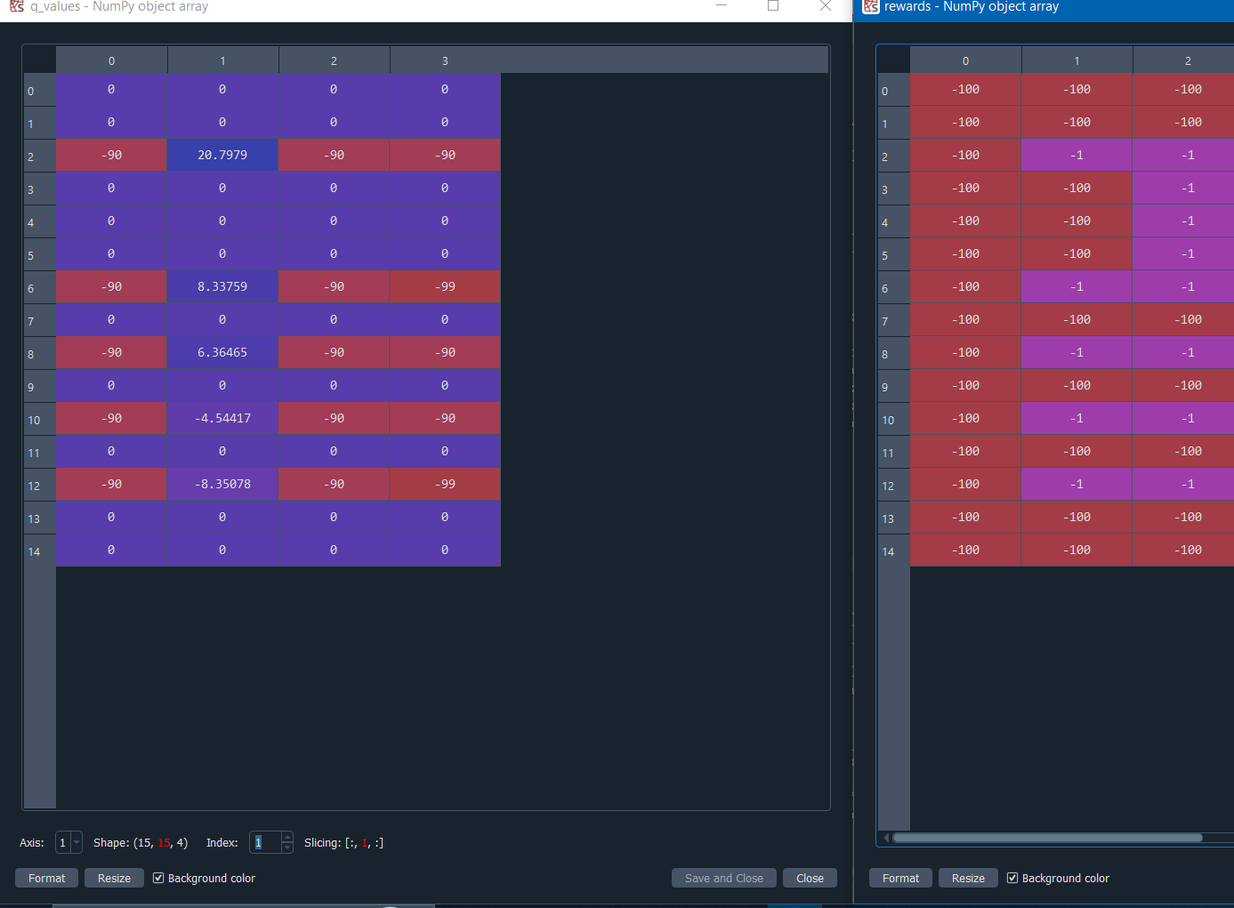
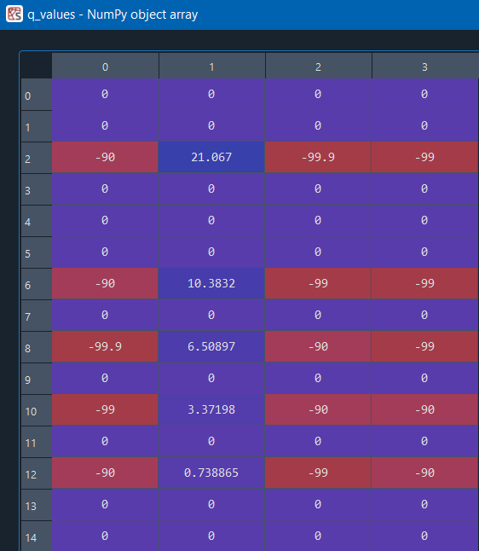
Results
750 iterations
1500 iterations

Slide 11
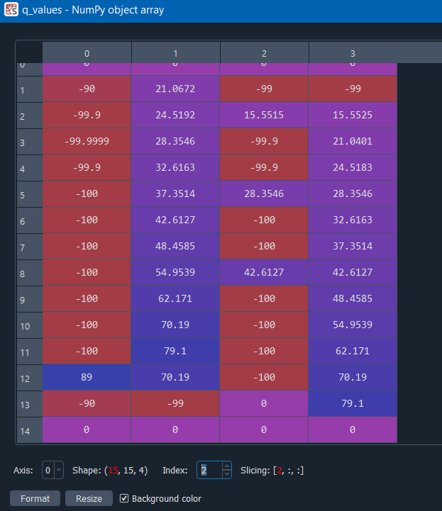
Results
1500 iterations
2000 iterations

Slide 12
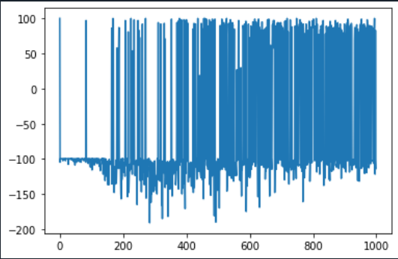
Reward in every-episode

